Slide 1


Slide 2

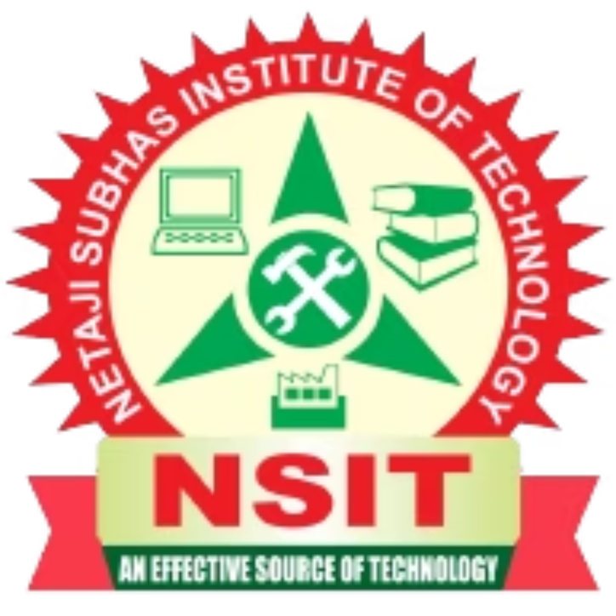
Technology-Driven Business & IoT
How Technology and IoT Are Changing Modern Businesses
Presented by: Supragya Sinha , Shreya Singh | Course: BCA | Roll Number: 2630311 , 2630333
Notes:
1

Slide 3
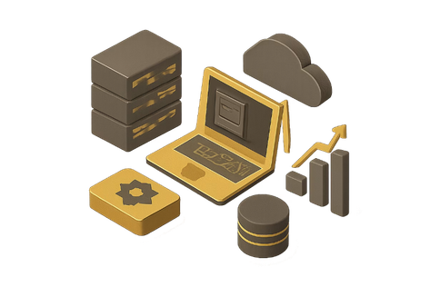
What is a Technology-Driven Business?
A technology-driven business uses technology to improve the way it operates, serves customers, and makes decisions.
Online Shopping & Digital Payments
Cloud-Based Business Operations
Artificial Intelligence & Automation
Scalable, flexible systems accessible from anywhere
Seamless transactions powered by digital infrastructure
Smart systems that learn and act on data
Data-Driven Decision Making
Mobile Applications & Digital Platforms
Insights from real-time analytics guide strategy
Reaching customers wherever they are
"Technology is no longer just a support system — it has become a part of the business strategy."
Notes:
2

Slide 4
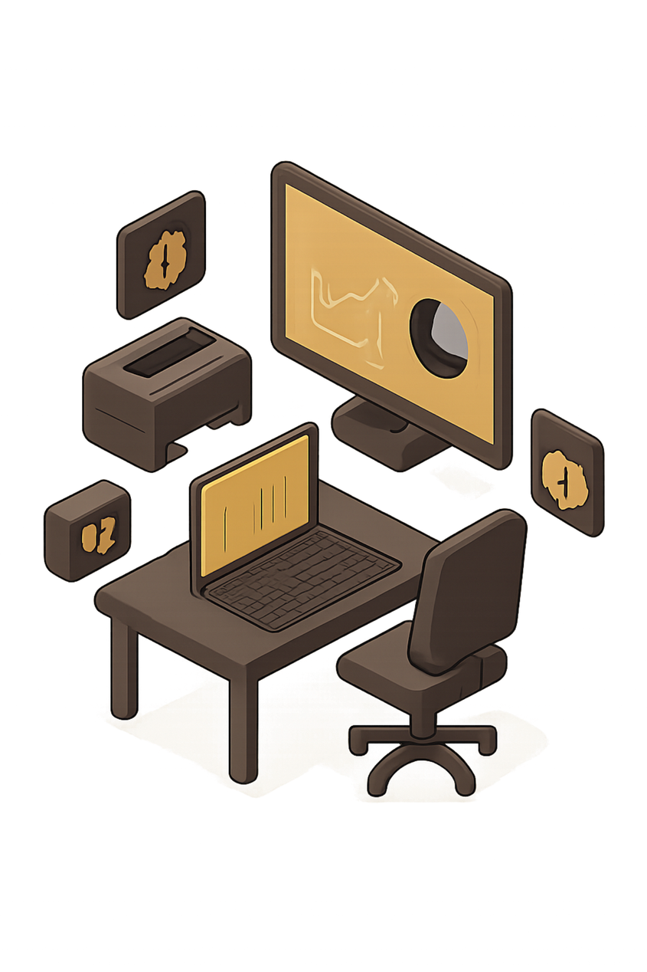

Why Technology Matters in Business
Technology helps businesses become faster, smarter and more efficient.
⚡ Faster Operations
💰 Lower Costs
📊 Better Decisions
Digital systems reduce operational expenses
Automation reduces repetitive manual work
Real-time data helps understand what's happening
😊 Better Customer Experience
🌍 Wider Reach
Businesses can reach customers beyond their physical location
Apps, chatbots and personalized services make interactions easier
Notes:
3

Slide 5
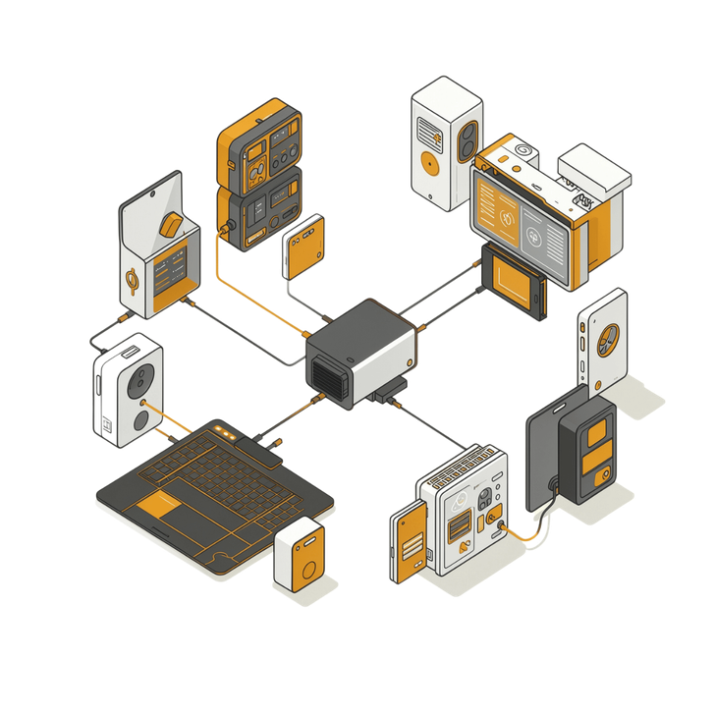
Introduction to IoT
IOT = INTERNET OF THINGS
IoT refers to physical objects connected to the internet that can collect, share and act on data.
Common Examples:
  Smart watches & Smart TVs
  Smart homes & Connected cars
  Industrial machines
  Smart agriculture systems
How IoT Works:
Device → Sensors → Internet → Data → Analysis → Action
Notes:
4

Slide 6
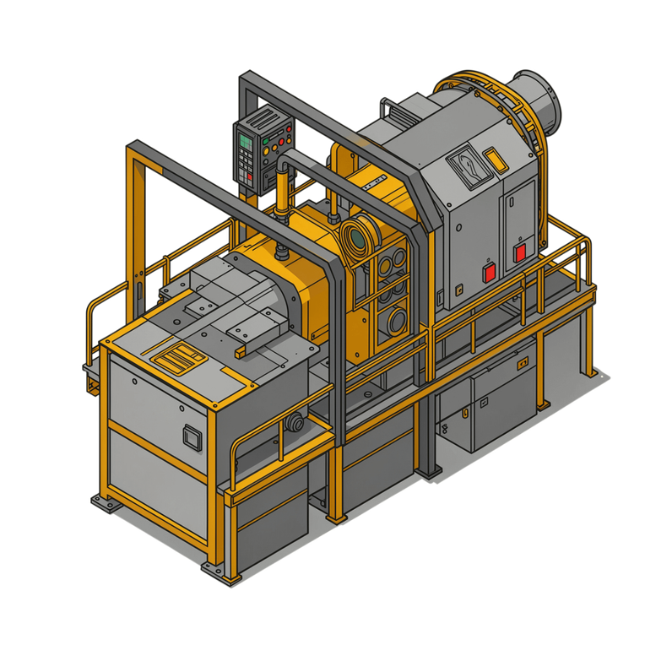

How IoT Helps Businesses
IoT allows businesses to understand their physical operations in real
time through predictive maintenance.
Example: Factory Monitoring
Instead of waiting for a machine to break down:
01
02
Sensor detects abnormal vibration
Data is sent to the system
03
04
Business Benefits:
System identifies the problem
Maintenance team receives an alert
  Less machine downtime
  Reduced maintenance costs
  Better productivity
  Real-time monitoring
  Improved resource management
Notes:
5

Slide 7

Real-Life Applications of IoT
IoT is already transforming operations across industries.
🏭 Manufacturing
🏥 Healthcare
Smart machines & predictive maintenance
Remote patient monitoring
🚗 Automotive
🛒 Retail
Connected cars with real-time intelligence
Smart inventory management
🌾 Agriculture
🏠 Home
Soil & crop monitoring systems
Smart lights, cameras & appliances
Key point: IoT connects the physical world with the digital world.
Notes:
6

Slide 8
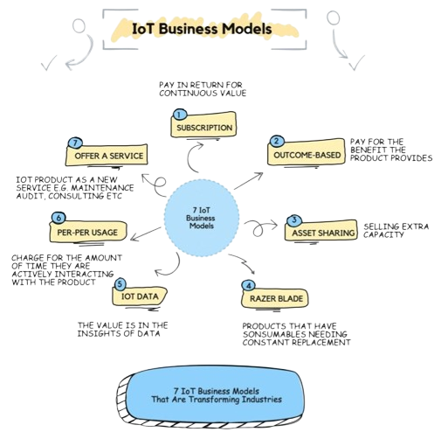
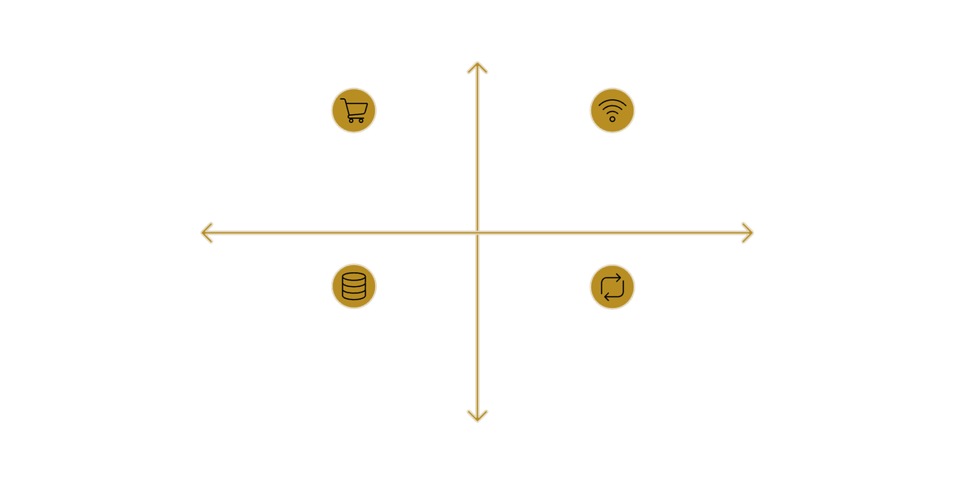
IoT Business Model
IoT creates new revenue opportunities beyond traditional product sales.
High Customer Value
Traditional: Product Sale, Transaction Ends
IoT: Sell Product and Connect Device
Low Connectivity
High Connectivity
Example in Practice
IoT: Collect Data and Provide Service
IoT: Ongoing Relationship & Recurring Revenue
A company selling industrial machines can also provide monthly monitoring services using IoT sensors, creating recurring revenue instead of depending only on product sales.
Low Customer Value
Traditional Model
IoT-Based Model
One-time transaction, no ongoing relationship
Continuous service, data insights & long-term loyalty
Notes:
7

Slide 9

Challenges of IoT in Business
While IoT offers significant opportunities, businesses must address key challenges.
🔐 Data Security
💵 Initial Investment
Connected devices can become targets for cyberattacks
Sensors, networking and software require upfront investment
📡 Connectivity Issues
📊 Large Amounts of Data
IoT devices depend on reliable communication networks
Businesses need proper systems to store and analyze data
👨‍💻 Skilled Workforce
Companies need people who understand IoT, software and data
Notes:
8

Slide 10
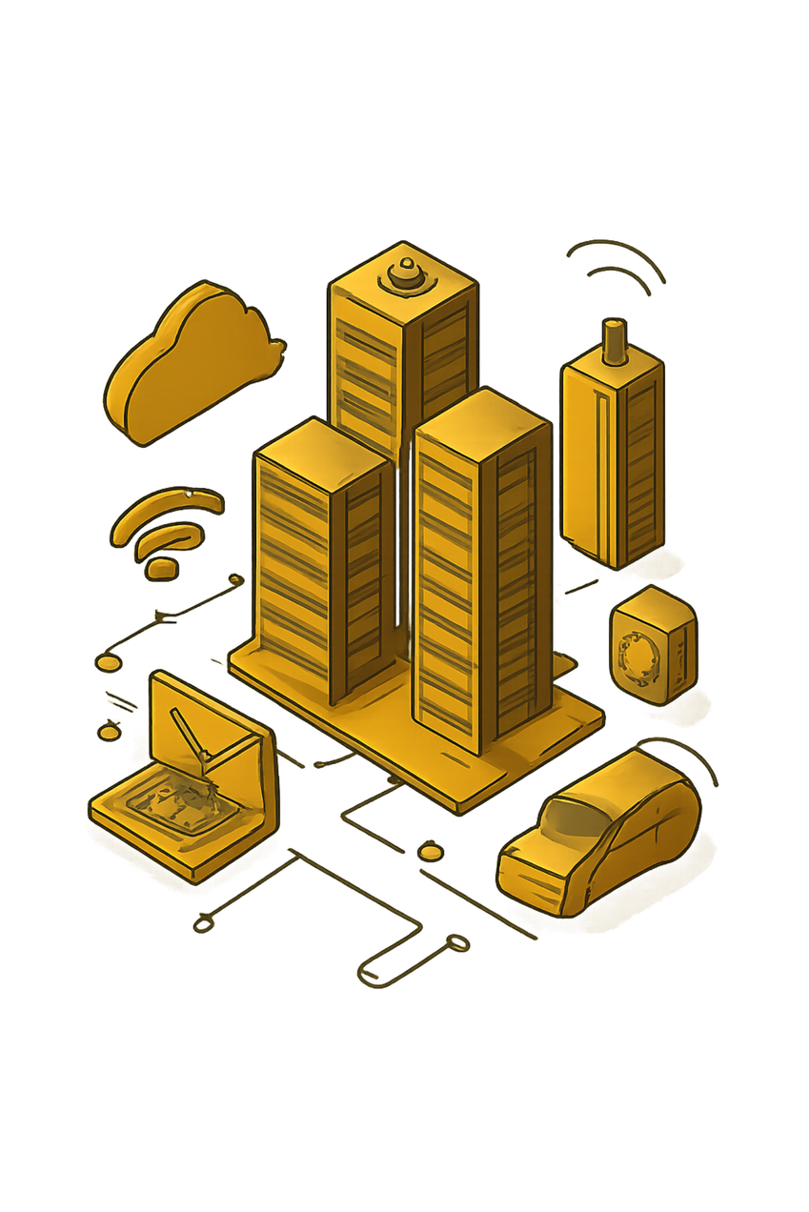





Future of Technology-Driven Business
The future will involve deeper integration between IoT, AI, Cloud Computing and Automation.
What We Can Expect:
🤖 AI + IoT
☁️ Cloud + IoT
Smarter automated decisions
Access data from anywhere
🏭 Smart Factories
🚗 Connected Vehicles
Highly automated production
Real-time vehicle intelligence
🏙️ Smart Cities
Efficient traffic, energy & infrastructure
Future vision: Businesses will not simply use technology — they will be built around it.
Notes:
9

Slide 11
Key Takeaways
Efficiency & Competitiveness
Real-Time Data
Cost Reduction
Thank You….
IoT connects physical devices and collects real-time data
Businesses can use IoT to reduce costs and improve services
Supragya Sinha , Shreya Singh
BCA | Roll No. 2630311 , 2630333
Technology improves business efficiency and competitiveness
Data as an Asset
The Future Formula
Data is becoming an important business asset
IoT + AI + Cloud + Automation will shape future businesses
Notes:
10

